Slide 1
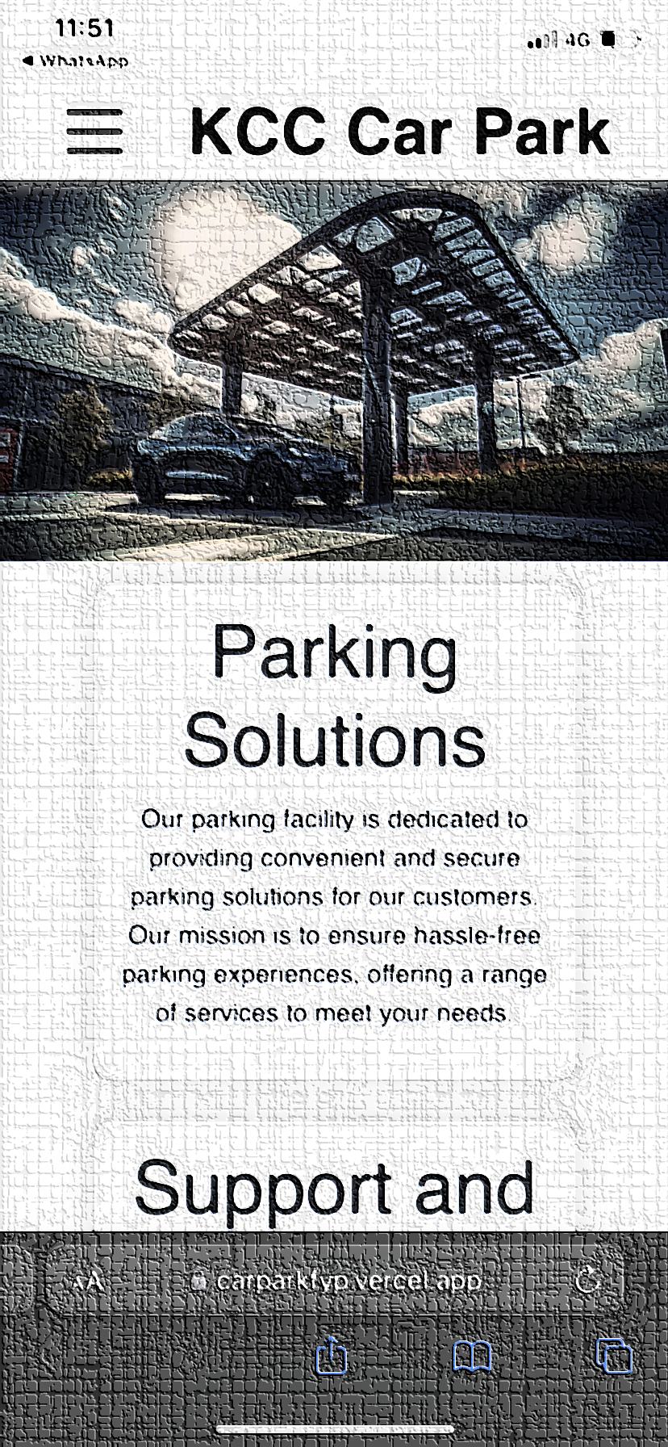
IoT-based Smart Parking System for KCC car park in Sri Lanka
K.B.M Pubudu Deepamal (CB011613)
K.B.M Pubudu Deepamal (CB011613)
Notes:
This PROJECT title gives a brief explanation About my project. It is that this project is designed for the Kandy KCC car park and This is a vehicle control system with innovative technology.

Slide 2
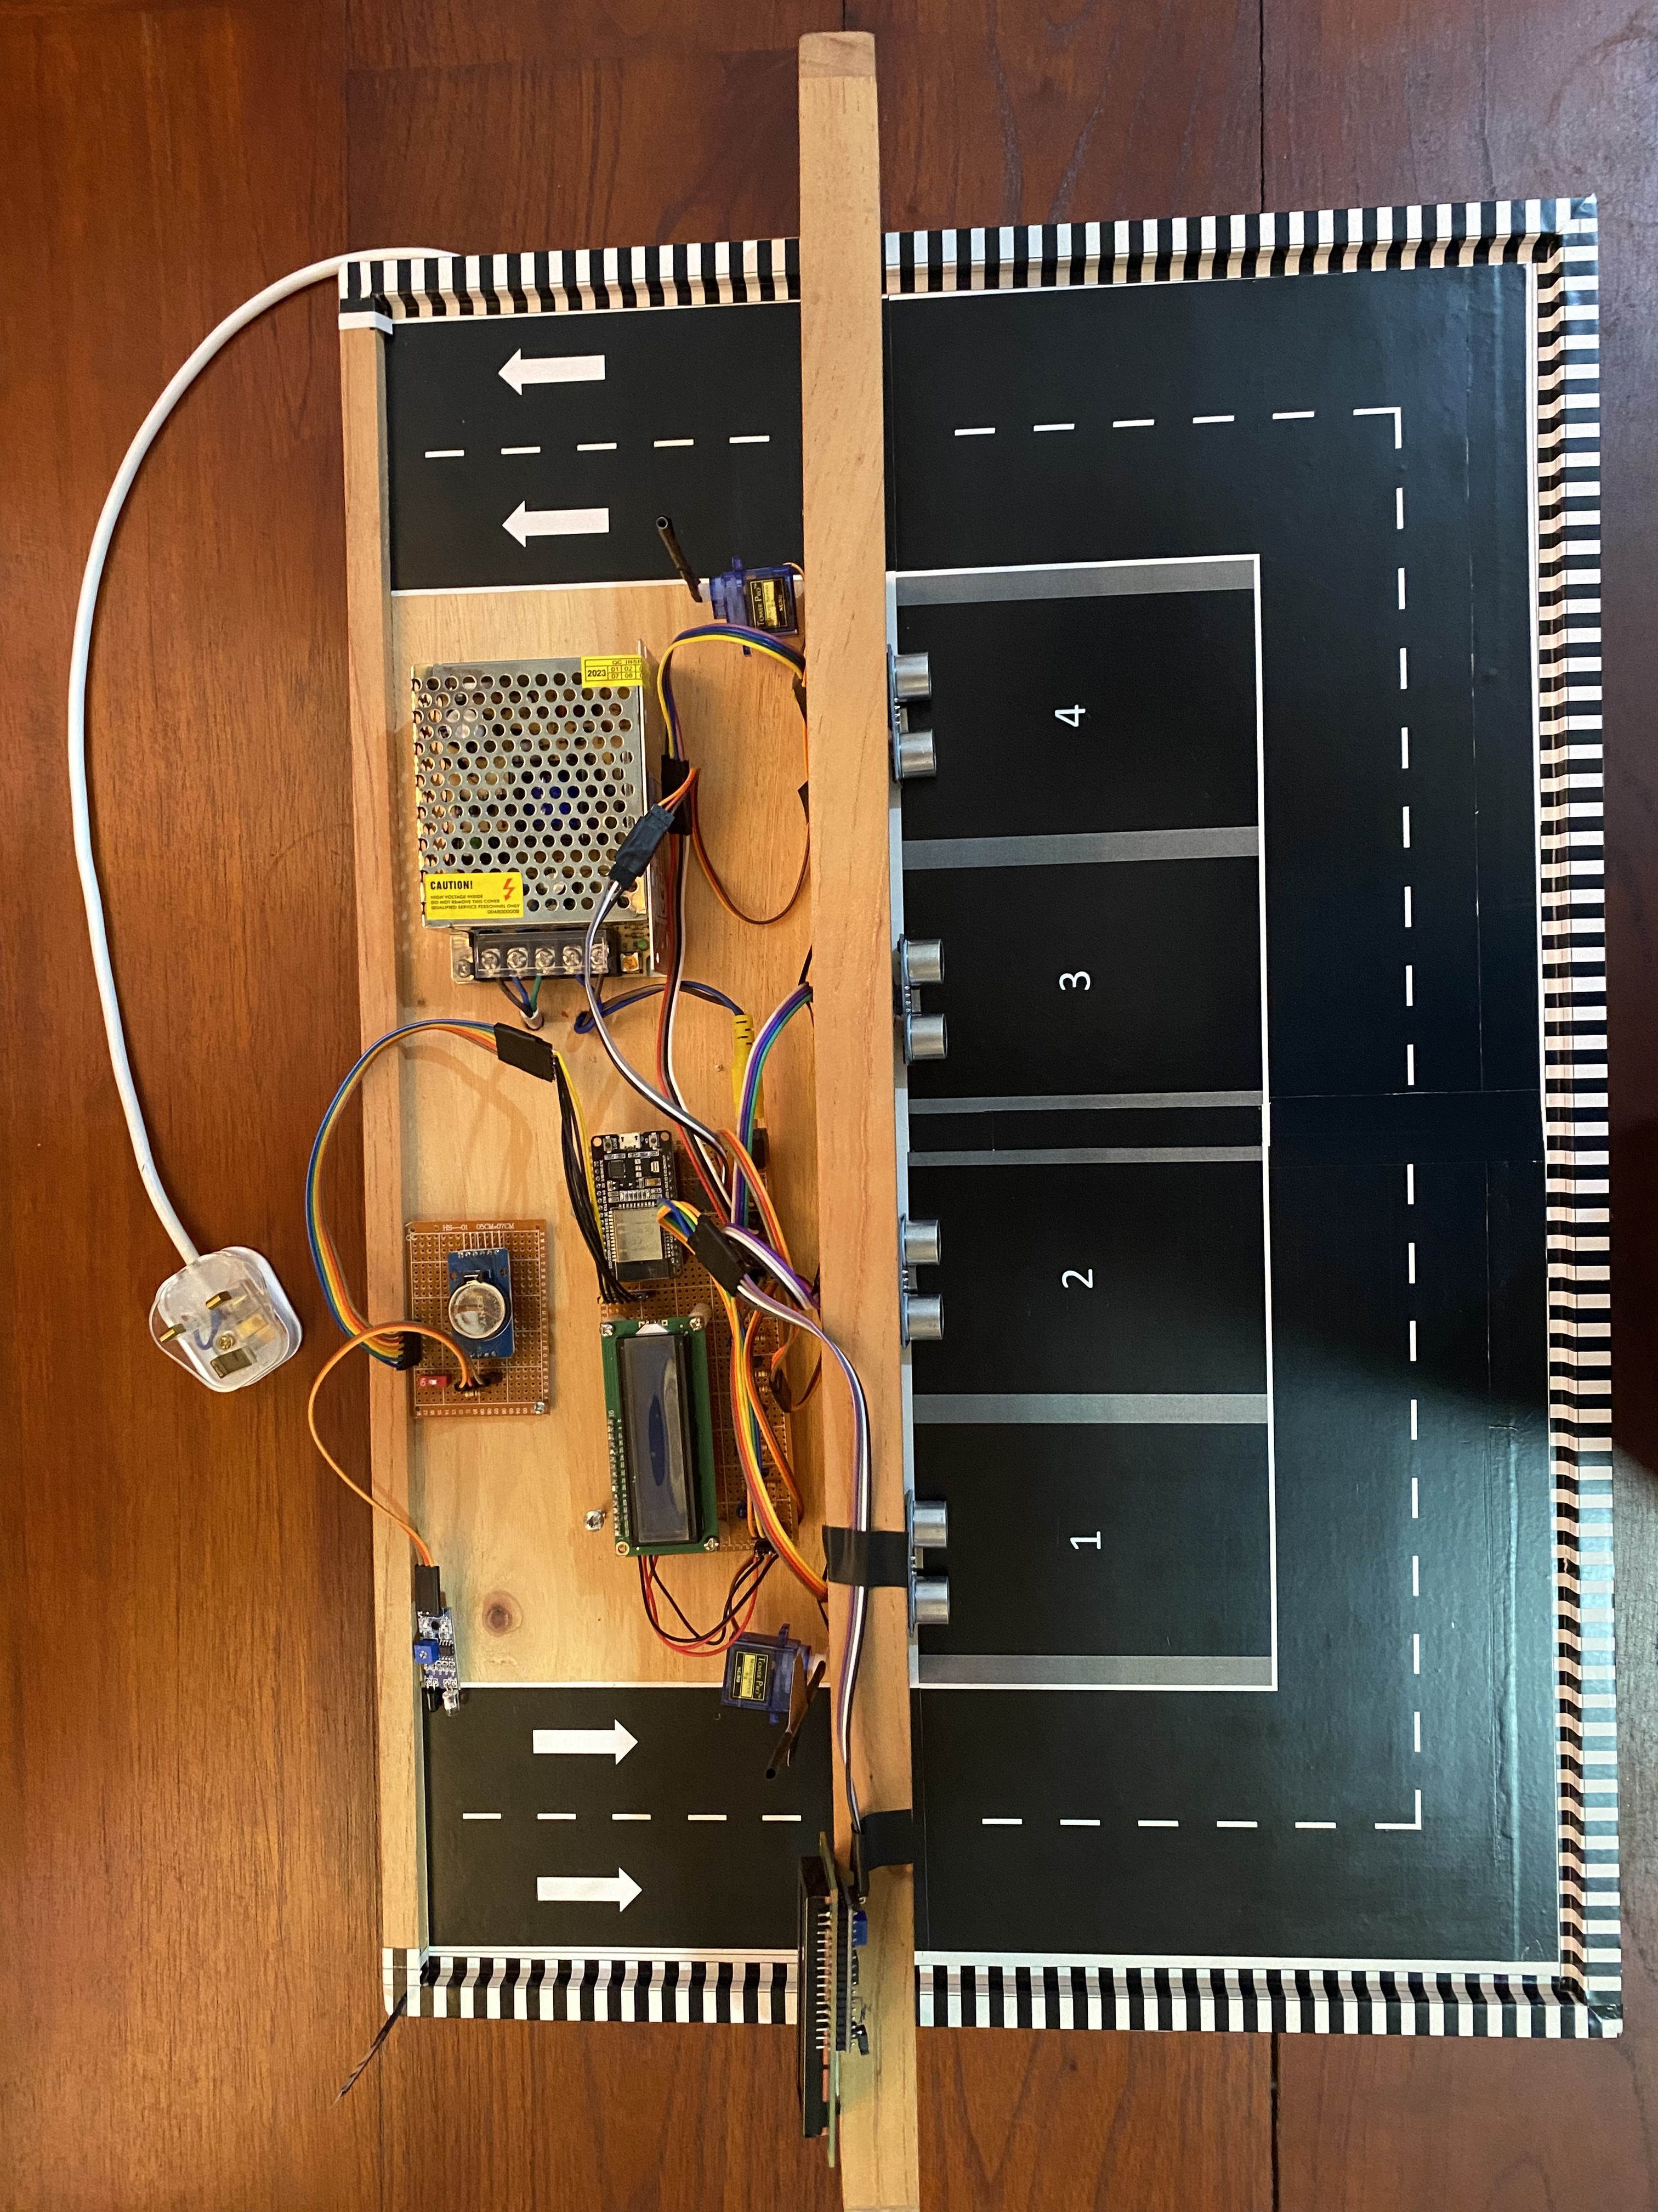
Table of contents
01
02
03
04
05
06
Problem context
Solution Concept
Implementation
Testing and Evaluation
Future Enhancement
References
Notes:
In this part given a brief explanation of my presentation And how it flows.

Slide 3
Problem context
Notes:
This project was created to give a solution real problem in kcc car park

Slide 4
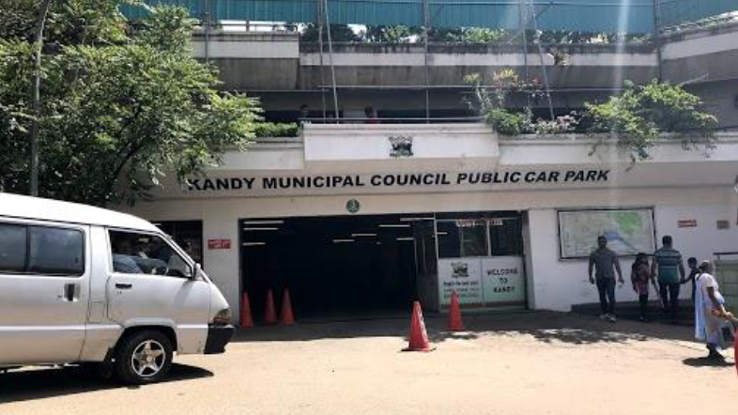
We turn challenges into opportunities!
Do you have previous experience using the KCC car park?
Yes
No
How do you rate current parking system?
Good
Average
Poor
Notes:
often

Slide 5
To conduct this primary research, data collection was done in two main ways.
The first way is to meet ten people and interview them.
The second way is to collect data using a Google form. (Data were collected from forty individuals in this manner)

Slide 6
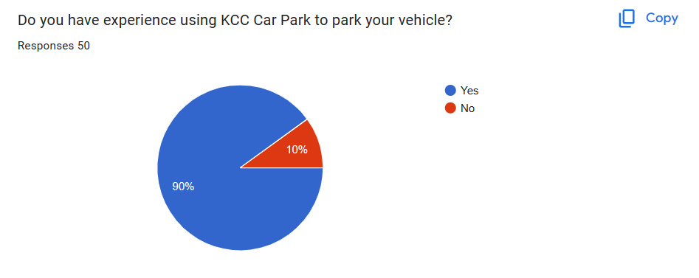
Do you have previous experience using the KCC car park?

Slide 7
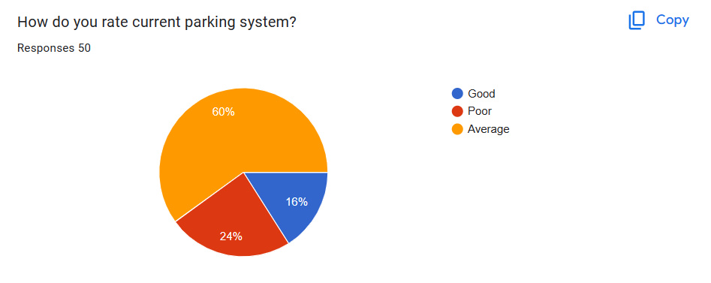
How do you rate current parking system?
Notes:
I contacted people of several age groups, male and female for this research.

Slide 8
KCC Current parking system Analysis
Parking Capacity
Technology
User Experience
Notes:
Why do drivers face the problem of finding a place to park despite the fact that there are facilities for drivers to park in this car park?

Slide 9
Analysis the Problem
Why do drivers face the problem of finding a place to park despite having facilities for drivers to park in this car park?
Existing inefficient management system.
Internal traffic.
Lack of understanding of the number of vehicles in the parking lot.
Notes:
Why do drivers face the problem of finding a place to park despite the fact that there are facilities for drivers to park in this car park?

Slide 10
Solution Concept

Slide 11
Project Objectives
To propose and implement an IOT-based solution process to increase the efficiency of the car park by studying the management system in the Kandy City Centre car park.
Increase efficient space in the car park.
Decreasing the environmental impact.
Notes:
මුදාහරිනවා : releasing

Slide 12
Implementation

Slide 13
Implementation
Iot based smart parking system prototype Implementation.
Web application Implementation.

Slide 14
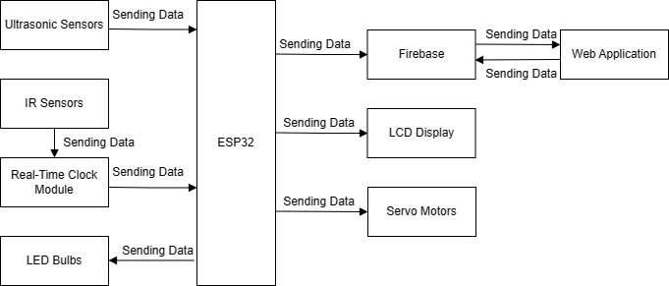
Implement the IoT based smart parking system.

Slide 15
Prototype Implementation

Slide 16
Tools used for Smart Parking System
Ultrasonic Sensors
Breadboard
IR Sensor
Pin headers
ESP32 Wireless Communication Protocol
Resistance
Real time clock module
Servo Motors
Power Pack (S-25-5)
Liquid crystal display
Jumper wire
Notes:
Instead

Slide 17
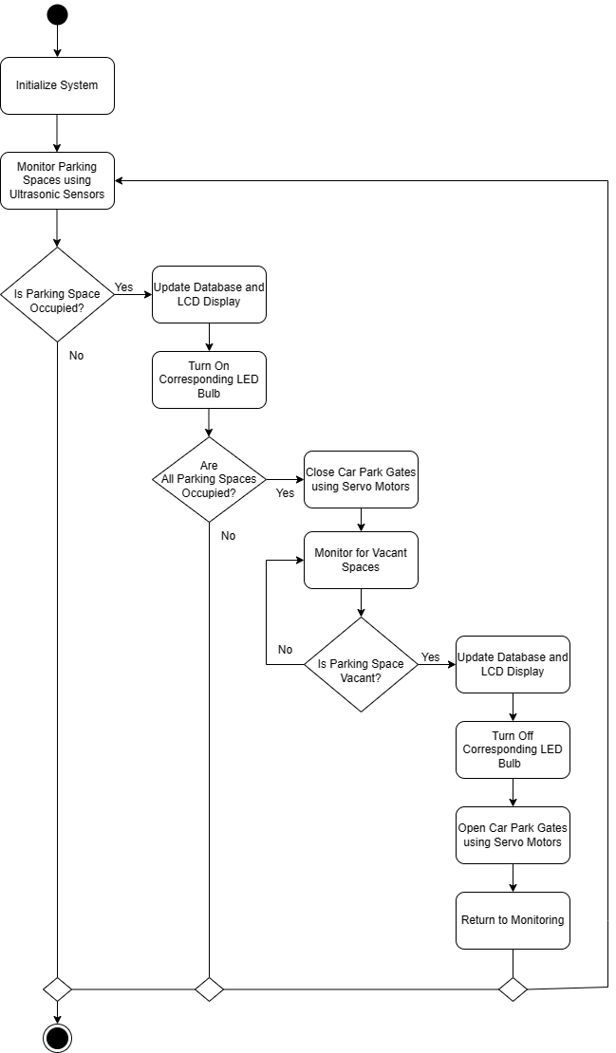
Activity diagram of the vehicle detection system

Slide 18
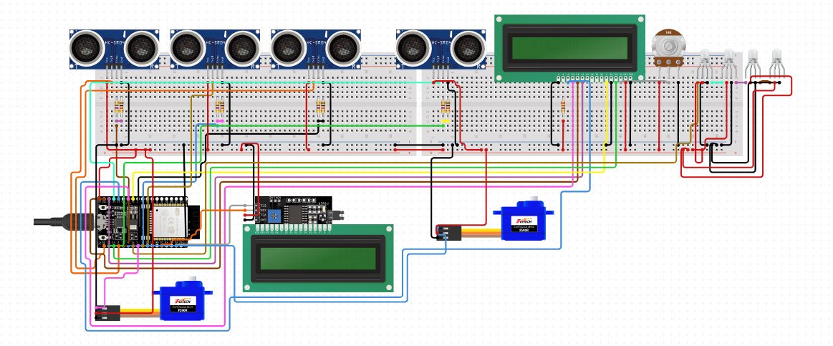
Circuit diagram of the vehicle detection system

Slide 19
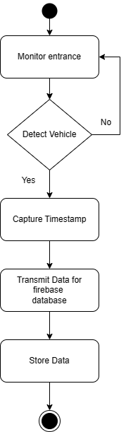
Activity diagram of the vehicle counting system

Slide 20
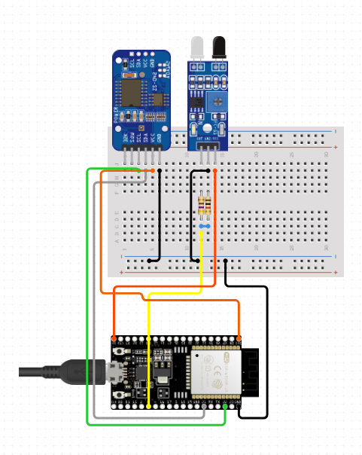
Circuit diagram of the vehicle counting system

Slide 21


Technology used for Smart Parking System
Language: C++
Development tool: Arduino IDE.

Slide 22
Database Implementation

Slide 23
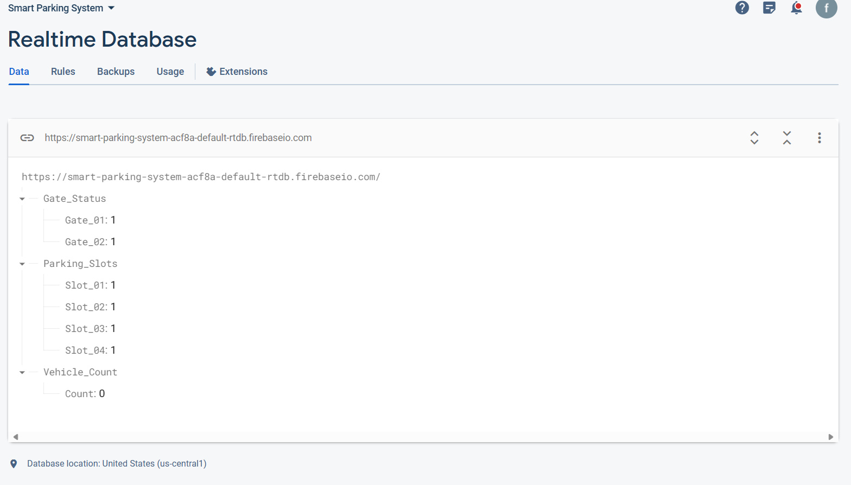
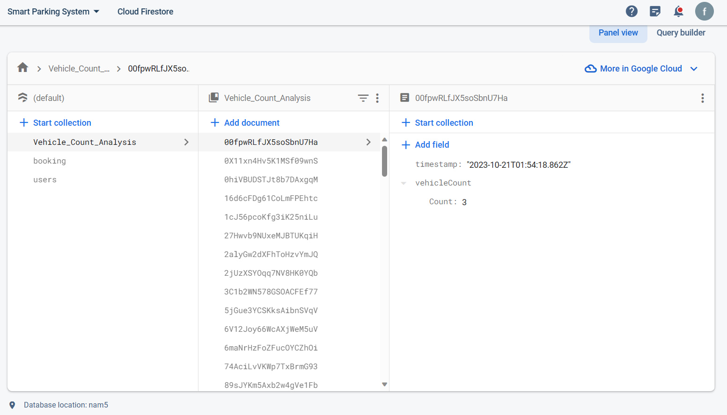
Implementation of Firebase Database
Firebase Realtime Database / Firebase Firestore Database

Slide 24
Web application Implementation

Slide 25


The technology used for the Web Application
Vue.js JavaScript framework
Bootstrap front-end framework

Slide 26


The technology used for the Web Application
Vercel
GitHub

Slide 27
Project Demonstration

Slide 28
Testing and Evaluation

Slide 29
Testing methods
Mainly Used automation testing method and manual testing method to test project.
Testers use a lot of technologies and testing tools to do automation testing.
Google Lighthouse plugin
Developers do testing frequently combine manual testing and automated testing.

Slide 30
Prototype Testing
Ultrasonic sensors detecting the vehicle.
Gate open and close.
LCD display working properly.
Lighting the bulbs in the circuit.
IR sensors detect the vehicle.
ESP32 Wireless Communication Protocol is working properly.

Slide 31
Web application Testing
Contact Us form testing.
Booking form testing.
Login form testing.
Multiple devices with responsive design.
Multiple browser testing.
Database testing.

Slide 32
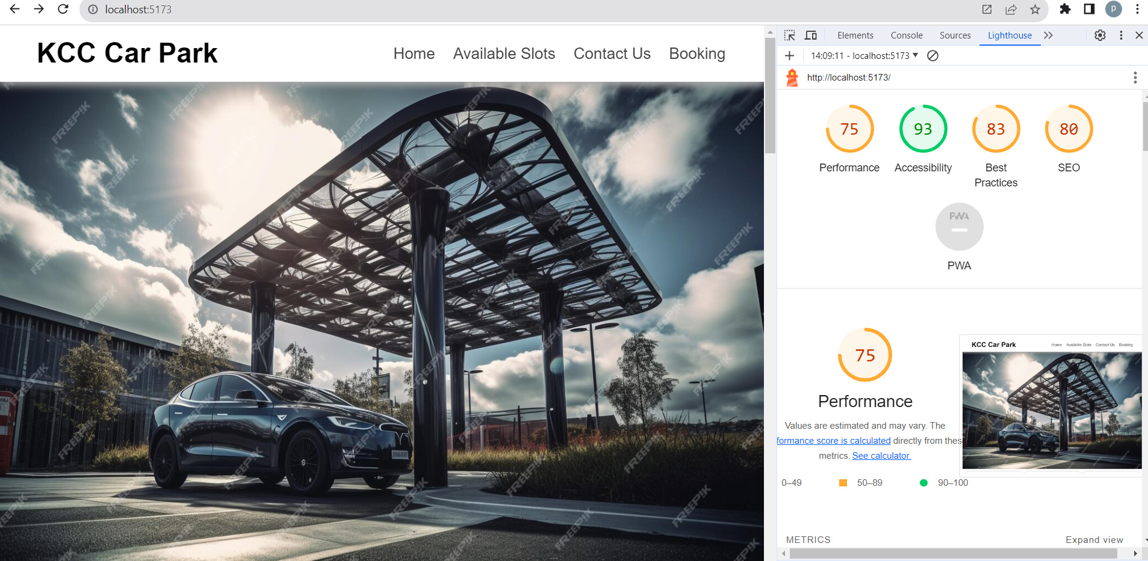
Web application Testing
Lighthouse is a plugin used for testing web application automation. It mainly tests Performance, Accessibility, and SEO in web applications.

Slide 33
Limitation and Key Challenges
Lack of knowledge about IoT: Before starting this IOT project, had limited knowledge
about IoT. That knowledge is not enough to continue this project.
The proposed system uses Ultrasonic Sensors and IR Sensors to detect cars, and it is
accuracy is not one hundred percent.
Transmitting the real-time information obtained from the sensor to web applications.

Slide 34
Future Enhancement
Introduce a mobile app for users to find and reserve parking spaces, mobile payment options and Show directions to the parking spot
Show the directions to the parking spot using the LCD displays and web applications.
Setting up a system to allocate parking spaces through web applications.
Add an Online payment system to a web application.
Using advanced sensors to detect vehicles. For example, LIDAR and radar

Slide 35
References
Lack of Parking in Big Cities: Reasons and Solutions Essay (2022).
SCOTT, R. (2023), ‘What is meant by the internet of things?’.
Singh, P., Singh, A. & Singh, A. K. (n.d.), ‘Social icons’.
Ultimate Guide to IoT-Based Smart Parking System (2023).
Imbugwa, G., Mazzara, M. & Distefano, S. (2020), Developing a mobile application using open source parking management system on ethereum smart contracts, in ‘Journal of Physics: Conference Series’, Vol. 1694, IOP Publishing, p. 012022.

Slide 36
Thank You !

